Slide 1
G25 LCMS

Slide 2
LCMS Basics
% Acetonitrile
% Water
IN
C18 Column
OUT
Three types of information
Retention time (most to least polar)
UV trace
Mass trace (m/z)

Slide 3
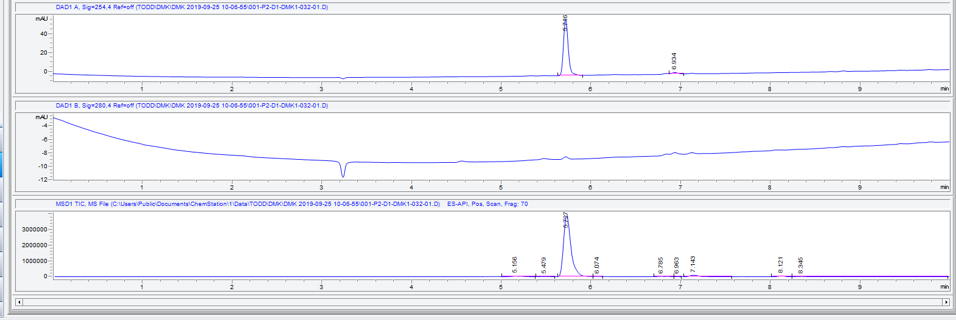
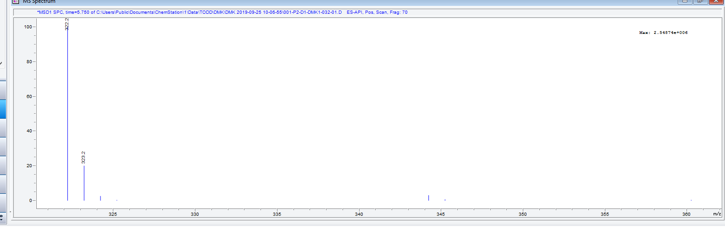
Liquid chromatogram (LC)
UV trace (254 nm)
Retention time (minutes)
UV trace (280 nm)
MS trace
TIC (<500000)
Mass spectrum (MS)
Ion identity [M+1]
Max ion count
Relative abundance

Slide 4
Common issues
Problem | Caused by
Over pressure/column blockage | Solids in sample (not filtered) Sample dissolved in solvent that is immiscible with water
Ion suppression | Injection of high concentrations of strongly ionizing substances (eg TFA)
Contaminants | Injection of high concentrations of substances that are retained on the column for multiple runs Plasticizers from improper storage of LCMS solvent
All of these can be avoided with good sample preparation.

Slide 5
!!! SAMPLE PREP !!!
Whenever possible, remove organic solvents. Avoid injecting crude reaction mixtures.
Dilute samples with HPLC grade water, ACN, or MeOH. Sample concentration should be ~0.01-0.1 mg/mL.
Filter samples through a 0.22 μm syringe filter.
Start with 0.1 μL injections and increase from there if necessary.
See email from Andrew regarding things to avoid putting onto the LCMS.

Slide 6
Further troubleshooting
Run a sequence rather than a single run with a wash cycle (WASH.M) after your samples.
Run the Wash_IPA.S sequence to remove impurities that show up in multiple runs.
You should be monitoring what is happening in your runs and adjusting accordingly.

Slide 7
Courtesy
Check solvent levels (ACN and water) and refill if necessary.
0.05% formic acid (0.5 mL/1000mL)
Filter the HPLC water using the filter in the Biotage hood
Do not prioritize samples unless given explicit permission.
If you are running >3 samples at a time, either run them at off-peak hours or break them up into multiple sequences and allow others to prioritize.

Slide 8
For more detailed information…
There is a tutorial printed and kept next to the LCMS.
The PDF version is saved on the LCMS computer.

